Slide 1
SUPERHERO U
FACEBOOK AD CAMPAIGN ANALYSIS
Data ANALYSIS
OPTIMIZING MARKETING SPEND

Slide 2
OUR TEAM
Team lead
Project Scribe
Project manager
Project Lead
Data ANALYSIS
Fathima Farhan k k
Rahat Parveen
Aritra Basu
Koushal Chouhan
Kavya
BalaGanesh
Neha Mathew
Gabriel Okwundu Kommurijayadeep
Siddivinayaka Sahukari

Slide 3
CONTENTS
Data ANALYSIS
Explanation of Superhero U event
Explanation of Facebook Ads
Overview of all of the Superhero U Ad campaigns
Dashboard
Recommendation for discontinuation of Ad campaign
Conclusion

Slide 4

EMPOWERING CHANGE : SUPERHERO U’S GLOBAL IMPACT AND STRATEGIC FACEBOOK CAMPAIGNS
Data ANALYSIS
Amplified Superhero U event engagement via strategic Facebook ads.
Reached diverse audience: students, educators, principals effectively engaged.
Aligned with UN's SDGs for meaningful impact and event purpose.
Fostering creativity, solving social issues through youth-developed 'Superheroes.'
Multi-round competition, Aug 2020 to Apr 2021, inspired participants positively.

Slide 5

UNLOCKING BUSINESS POTENTIAL : HARNESSING FACEBOOK ADS
Data ANALYSIS
Strategic Promotion Platform: Utilize versatile formats for effective campaigns.
Engaging Content Strategy: Link profiles for impactful outreach.
Audience Segmentation: Precise targeting for maximum engagement.
Driving User Actions: Prompt likes, comments, and shares.
Optimization and Visibility: Gauge success through metrics, elevate brand presence.

Slide 6
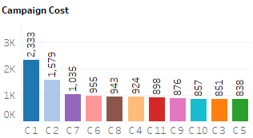
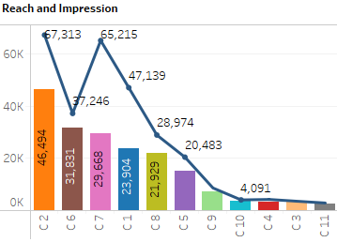
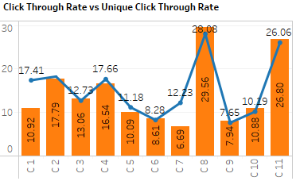
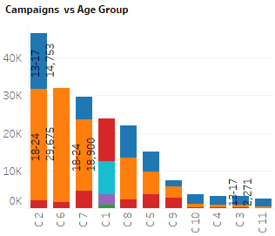
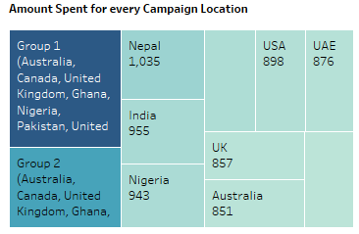
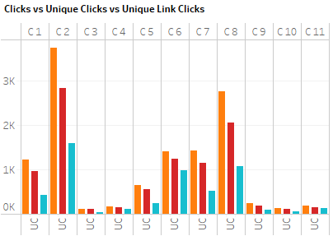

INSIGHTS DASHBOARD: UNVEILING AT A GLANCE
Data ANALYSIS
Click Here:

Slide 7
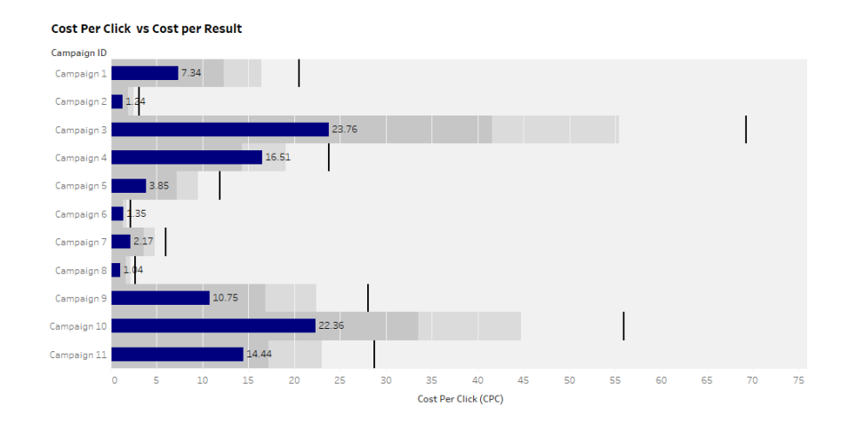
INSIGHTFUL CAMPAIGN ASSESSMENT AND PERFORMANCE
Data ANALYSIS
Insightful Campaign Assessment and Performance
Methodical evaluation using key metrics
Noteworthy success in Group 2 countries for students aged 18-24
CTR: 6.62%
CPR: 0.46
Contrastingly, campaign 3 for Australian students aged 25-34 underperformed, leading to its exclusion for cost-saving.

Slide 8
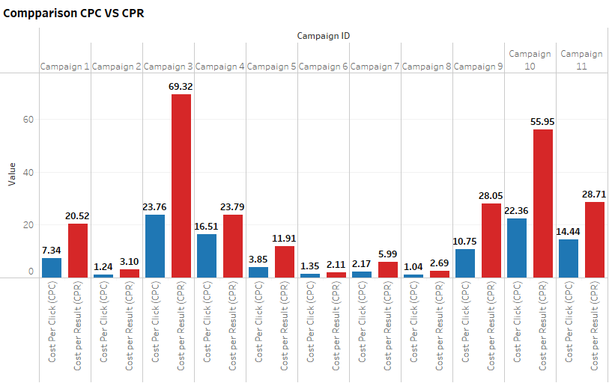
STRATEGIC RECOMMENDATION: DISCONTINUATION OF CAMPAIGN
Data ANALYSIS
Campaign Name: SHU_Students(Australia)
In-depth analysis reveals lower performance metrics
Suboptimal return on investment indicated
Recommendation: Discontinue the campaign

Slide 9
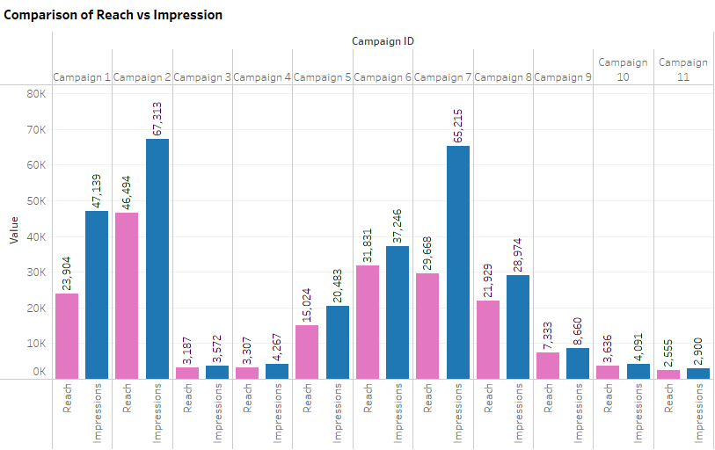
DATA VISUALIZATIONS STRENGTHEN DISCONTINUATION RECOMMENDATION
T
Clear evidence from visualized data
Unsuccessful engagement across Australian student segments (13-17, 18-24, 25- 34)
Performance below anticipated levels
Resource redirection to successful campaigns for optimal impact and cost efficiency.

Slide 10
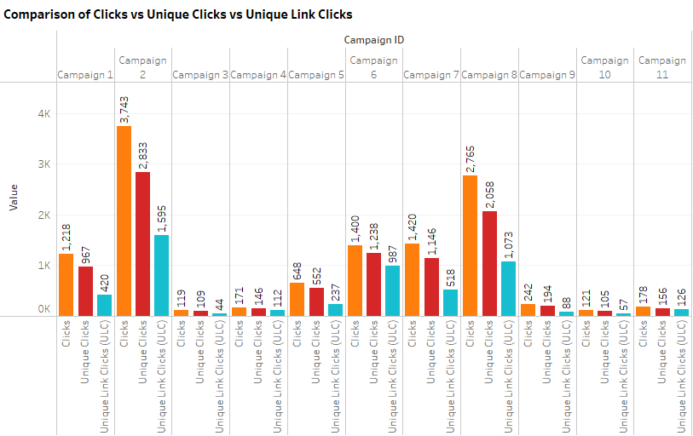
DATA-DRIVEN EXCELLENCE: ELEVATING SUPERHERO U'S
Data ANALYSIS
Marketing team's steadfast dedication.
Data-powered decision making and campaign optimization.
Strategic focus and efficiency assured.
Empowering Superhero U's vision to inspire and nurture youthful innovation.

Slide 11
OPTIMIZING IMPACT: STRATEGIC CAMPAIGN DECISION
Data ANALYSIS
In conclusion, the Marketing team emphatically recommends discontinuing 'SHU_Students(Australia)' Campaign 3. Data-driven insights underline inadequate performance metrics, warranting resource reallocation for optimal impact alignment.
Conclusion:
Strategic Discontinuation: 'SHU_Students(Australia)' Campaign 3.
Data-Driven Insights: Subpar metrics despite diverse age targeting.
Resource Optimization: Redirecting for amplified impact.
Commitment to Excellence: Ensuring campaign alignment for a brighter future.

Slide 12
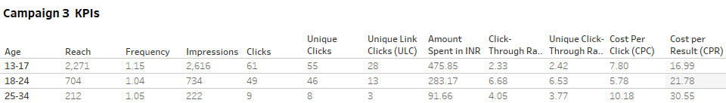
DRIVING SUCCESS AND IMPACT: A DATA DRIVEN JOURNEY
Data ANALYSIS
Moving forward:
Applying rigorous analysis to enhance strategies
Data-driven approach for empowering creativity and inspiring change
Reaffirming Campaign 3 discontinuation
Resource reallocation for impactful outreach
Superhero U's lasting world impact

Slide 13
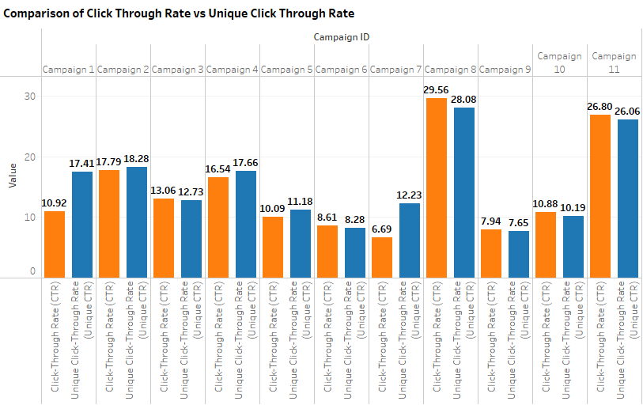
APPENDIX
Data ANALYSIS

